Slide 1
DX University
Visalia California – 2014

Slide 2
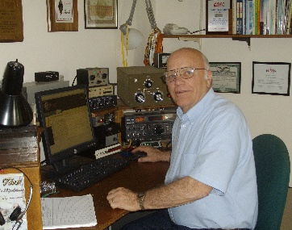
Organizers Welcome
Our aim today is to help beginning and casual DXers learn the basics of successful DXing, while making a minimal impact on the bands.
The DX University also discusses many of the more advanced techniques that allow experienced DXers to get in and out of a pileup in the shortest possible time.
Wayne Mills N7NG

Slide 3
DX University
Visalia California – 2014

Slide 4
Organizers Welcome
Roger Western, G3SXW
and
Wayne Mills, N7NG
How To Work Rare DX
Elements of Successful Calling
Wayne Mills N7NG

Slide 5
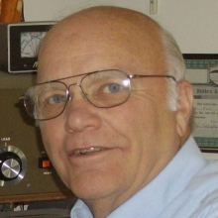
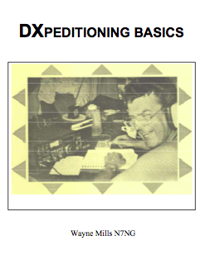
Wayne Mills N7NG
Serious DXer since the 1950s. DXpeditions since 1984 to FOØXX (2), ZL9, XF4L, 3D2AM, ZA1A, BV9P, BS7H, XZ1A, TXØDX and many others on all continents.
Contest efforts began in Aruba in 1988, and went on to include V51Z, 4U1ITU, ZL, XZ, PT5 and more.
Past DXAC Representative and Chairman – and Former head of Membership Services Dept. at ARRL for seven years.
Author of DXpeditioning Basics, an operating manual for DXpeditioners and numerous articles for QST, How's DX and the ARRL Operating Manual.

Slide 6
How to Find and Work the DX
Find DX to Work

Slide 7
How to Find and Work the DX
Do you have the DX station’s call correct?
Using spotting networks, it’s easy to get it wrong.

Slide 8
How to Find and Work the DX
Here’s What to Do Next

Slide 9
How to Find and Work the DX
Can you hear the DX Station?
No Pileup? No Problem.
Big Pileup! That’s a Challenge!

Slide 10
How to Find and Work the DX
What is a pileup?

Slide 11
How to Find and Work the DX
If it’s an expedition, what is the phase of the operation?
Early, Midway or Late?
Chances of making a QSO?

Slide 12
How to Find and Work the DX
Do you have reasonable propagation?
The better it is, the easier it will be to work the DX station.
If it’s poor, you might want to wait.

Slide 13
How to Find and Work the DX
Setting Up to Call

Slide 14
How to Find and Work the DX
Is the Station Operating Split?
(Uh…What is Split Operation?)
Why Is He operating Split?

Slide 15
How to Find and Work the DX
Define the Pileup:
Who is calling?
Limits of the pileup?
Lowest Frequency
Highest Frequency

Slide 16
How to Find and Work the DX
Working Split
Transmit on the DX Frequency?
(Avoid it at all costs!!)
Learn how to use your radio!

Slide 17
How to Find and Work the DX
You need equipment
that’s up to the task…

Slide 18
How to Find and Work the DX
Frequency Control
This is critical!
You need a radio that will work split.
You must avoid transmitting on the DX frequency.

Slide 19
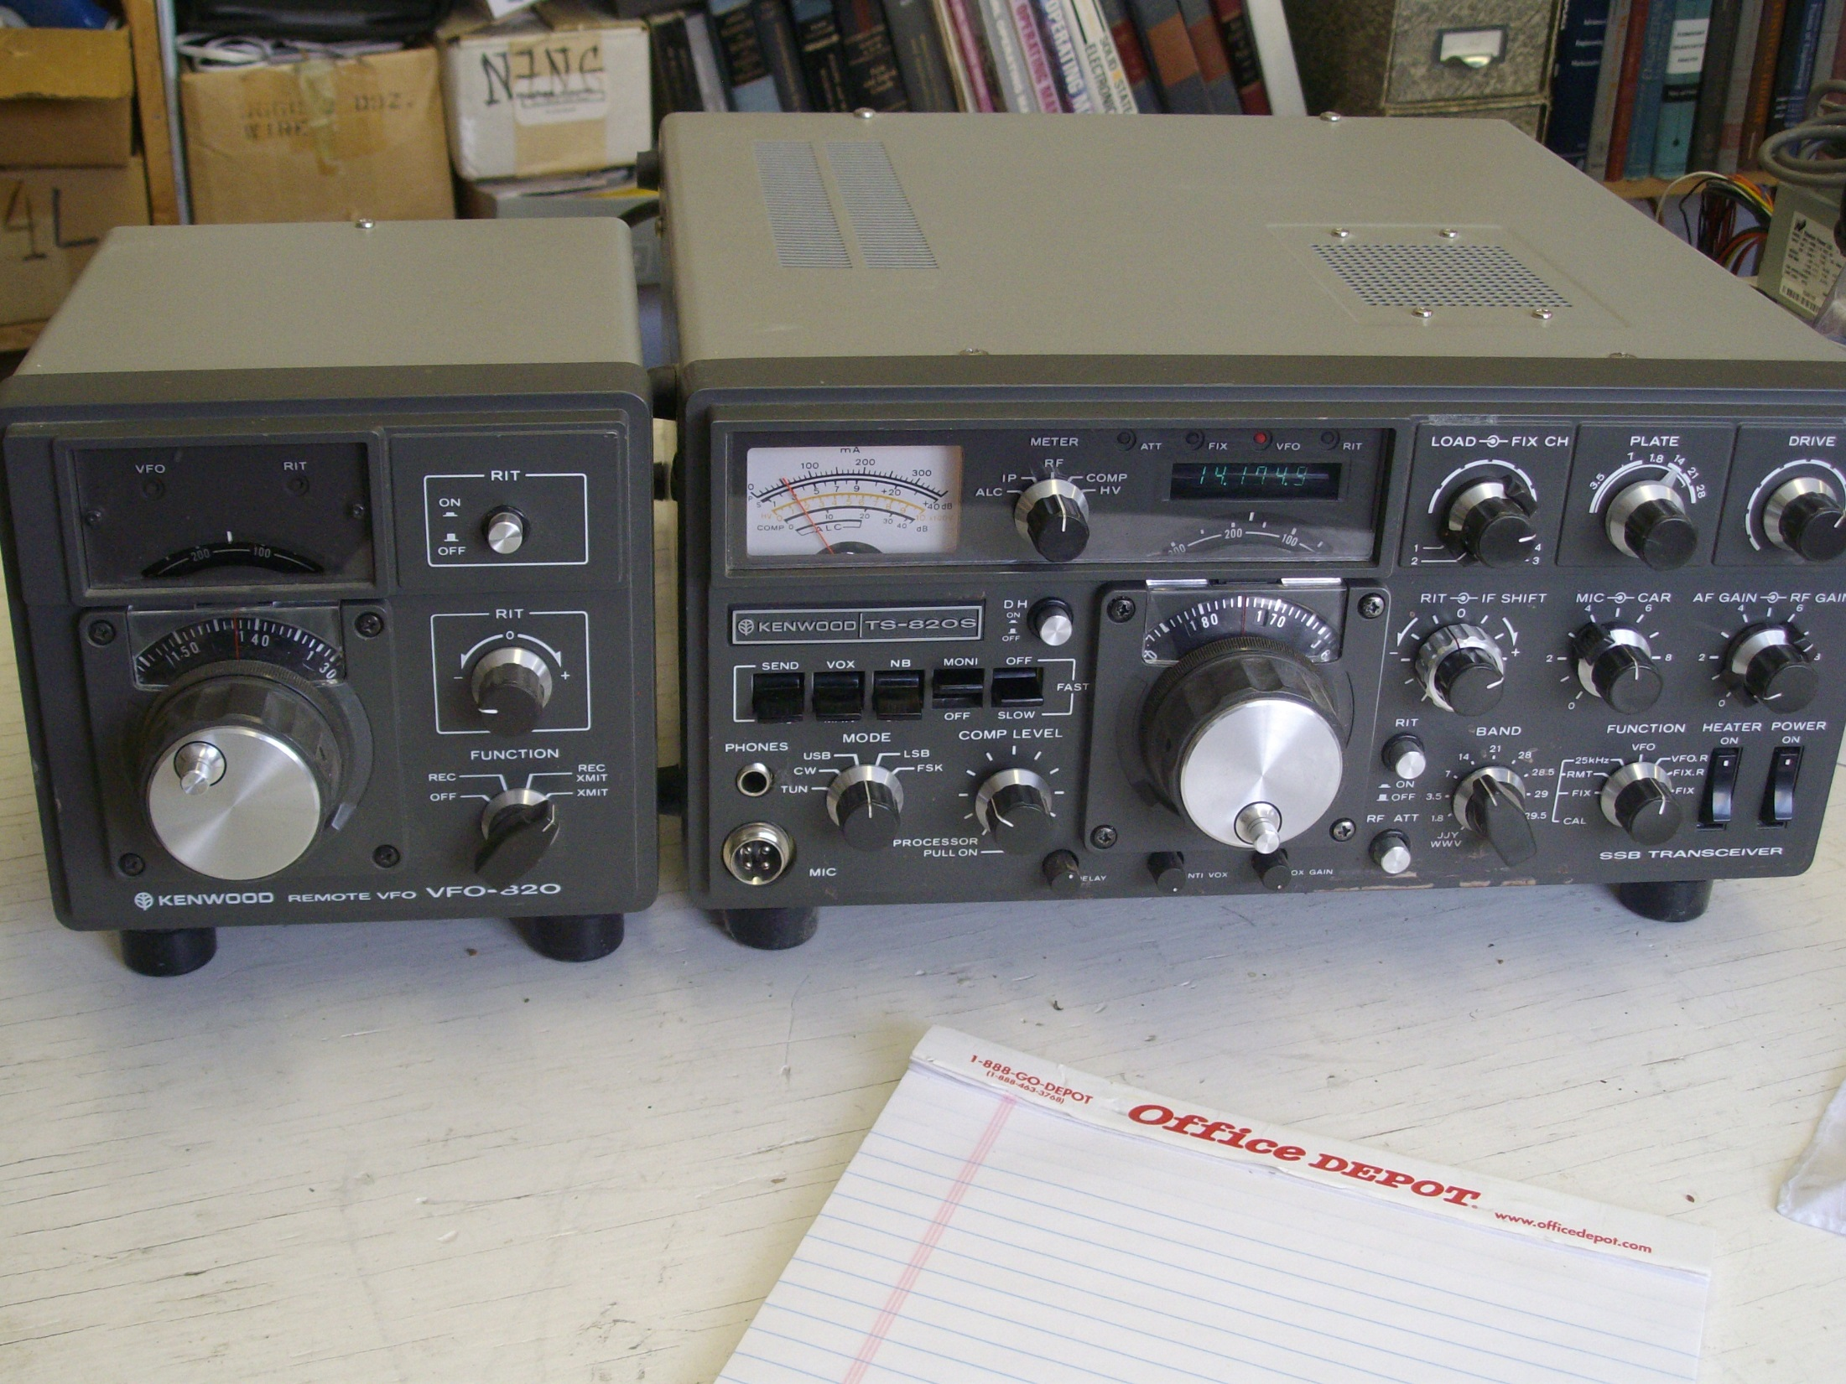

Slide 20
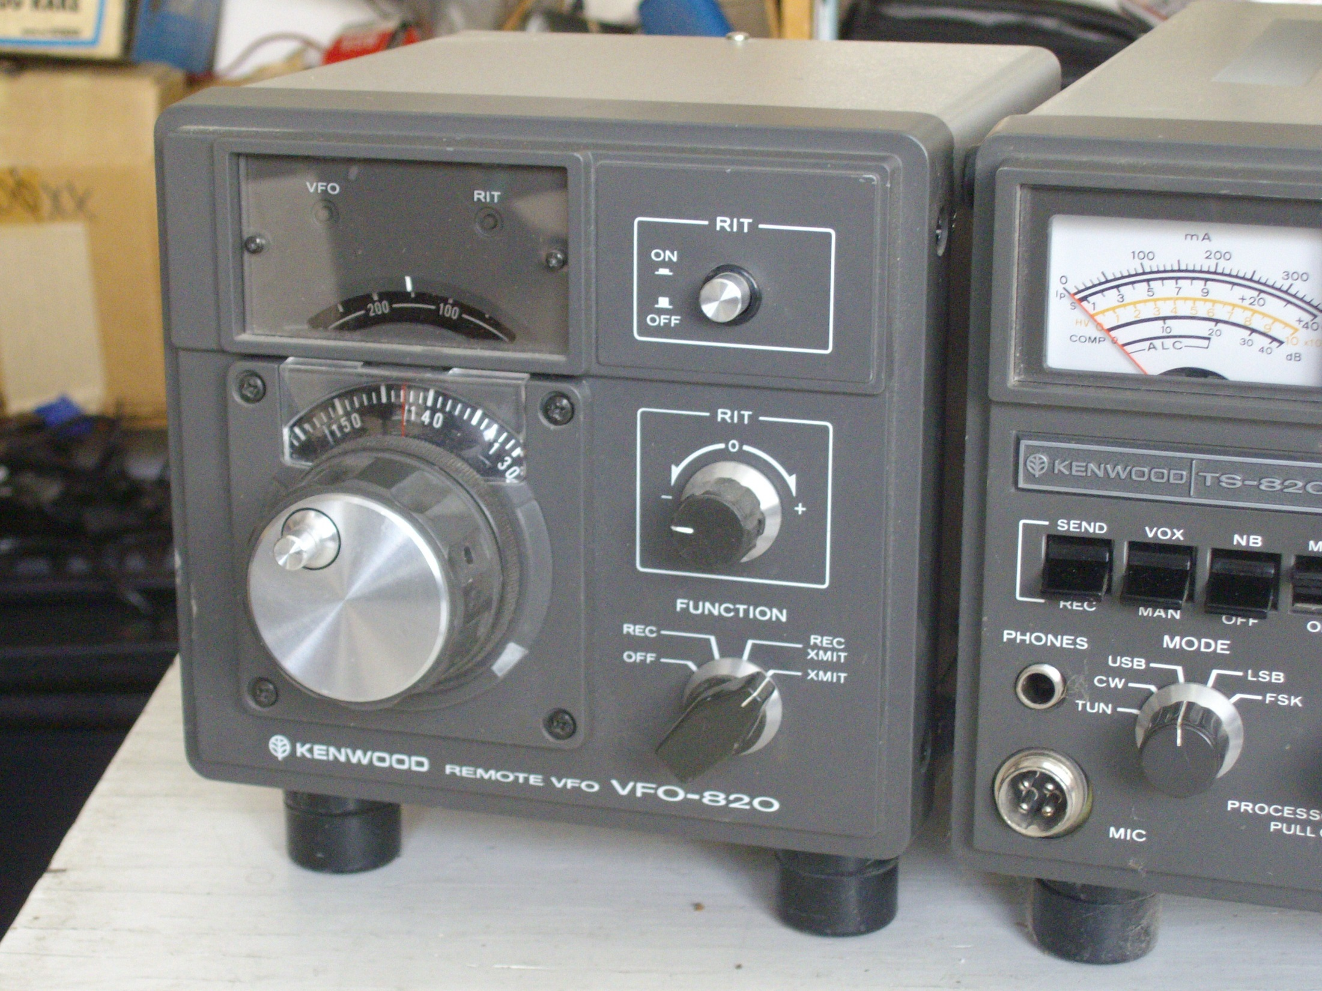

Slide 21
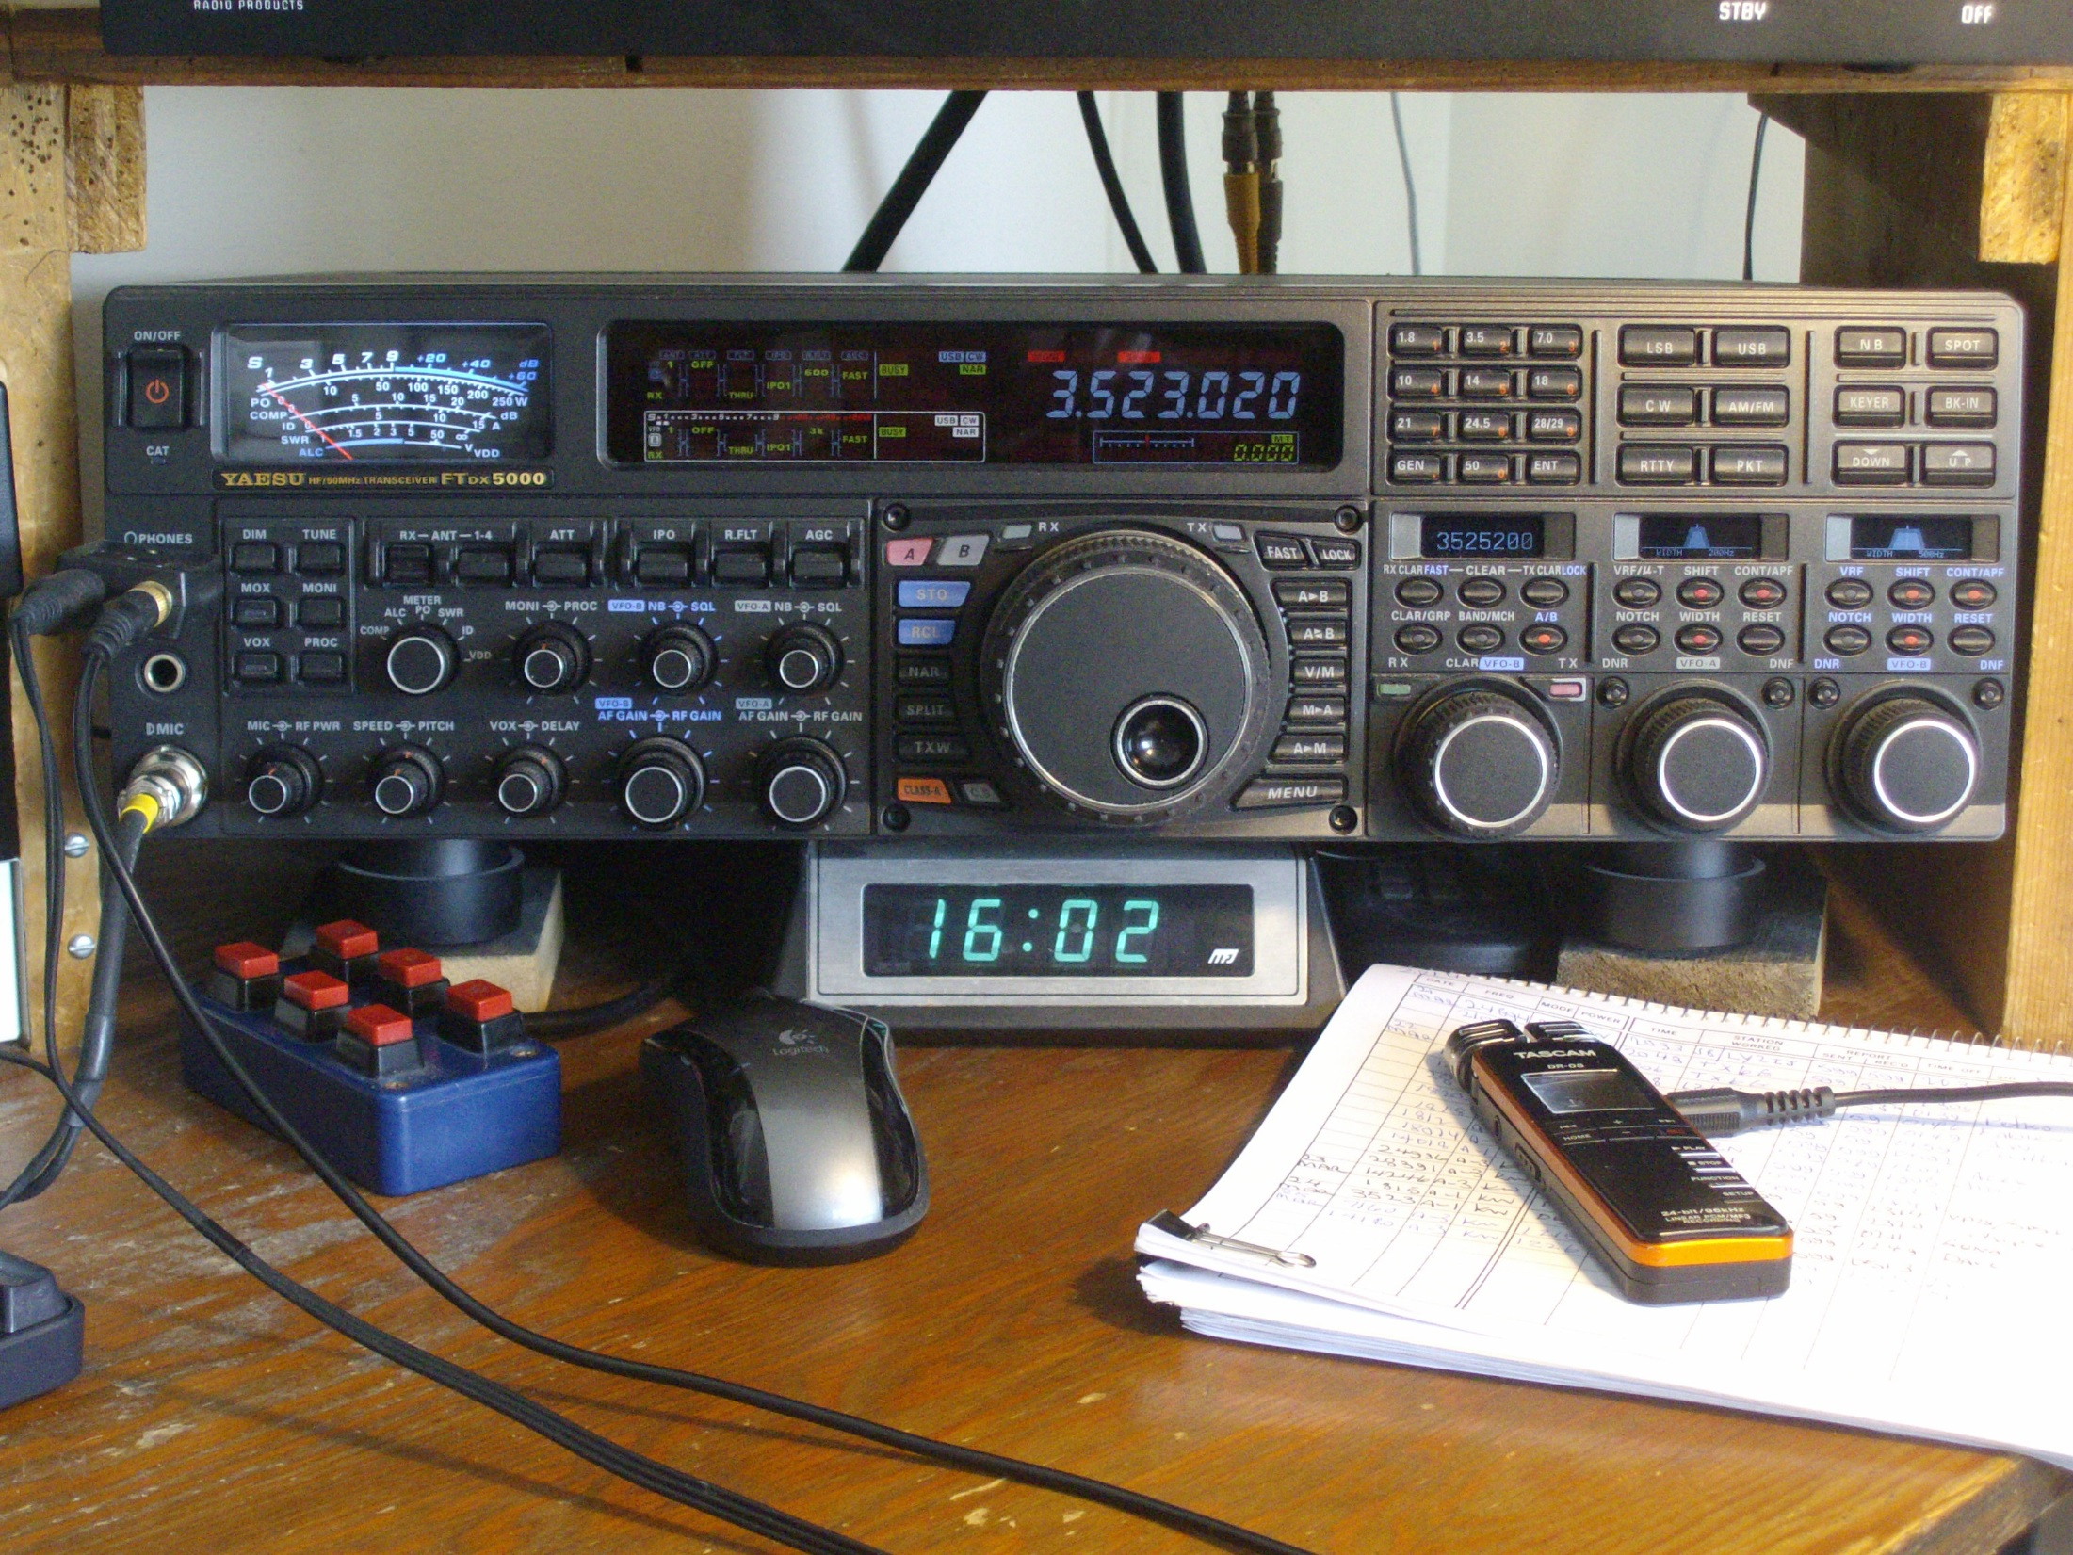
How to Find and Work the DX

Slide 22
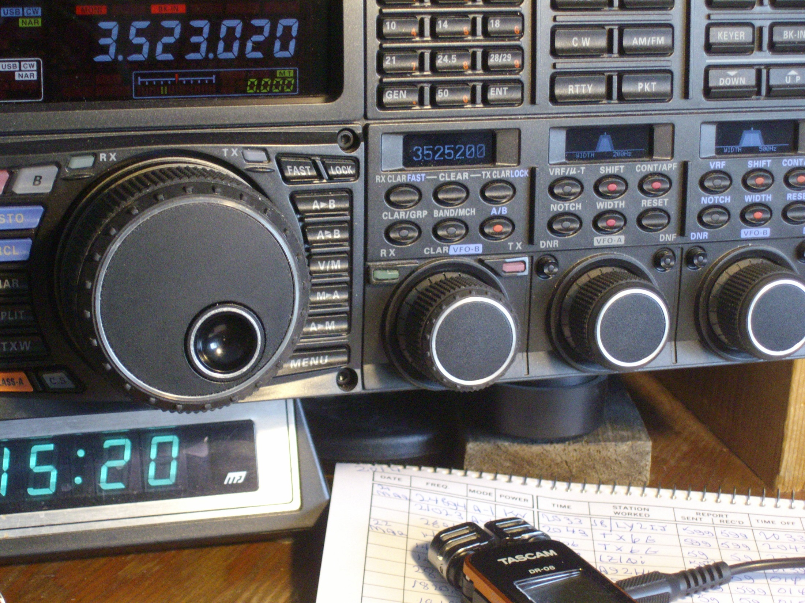

Slide 23
How to Find and Work the DX
When your radio is set up:
Where do I call?
How do I call? (Call once, listen)
How do I make a good QSO?

Slide 24
How to Find and Work the DX
Where is the station being worked?
Maybe you can Listen with a wide bandwidth

Slide 26
How to Find and Work the DX
Where to call next?
Probably NOT zero beat.

Slide 27
How to Find and Work the DX
Try to:
Learn the DX Operator’s Tuning Pattern
Tune and Listen and to find it

Slide 28
How to Find and Work the DX
Don’t know where to call?
Study the pileup.
Find a place where you can be heard.
Pick a relatively clear spot near
the edges of the pileup.

Slide 29
How to Find and Work the DX
Pileup too dense?
Wait until later

Slide 30
How to Find and Work the DX
How to call?
• How many times should you
call after each QSO?
• Critical:
Listen Between Calls

Slide 31
How to Find and Work the DX
The QSO:
Quick and “snappy”
(No names or QTHs)

Slide 32
How to Find and Work the DX
The QSO – Critical:
Don’t repeat your call if it’s already correct* Examples:
“QSL 5NN TU” on CW
“QSL Five Nine Thanks” on SSB
* Unless required by regulations

Slide 33
How to Find and Work the DX
Phonetics
– Use standard phonetics
The DX station is having difficulty:
– Vary your phonetics
– Use local names or locations

Slide 34
How to Find and Work the DX
Can’t make it?
QRX and wait for better propagation, or try a smarter tactic

Slide 35
How to Find and Work the DX
QRM on the DX Frequency?
Ignore it! Don’t add to the problem!

Slide 36
How to Find and Work the DX
Responsibility of the DX operator
Fairness and Consistency

Slide 37
How to Find and Work the DX
DXer Responsibility:
Following Instructions:
Listen carefully to instructions on both CW and phone.
Use Common Courtesy

Slide 38
How to Find and Work the DX
Visit the DX University Website for Best Practices for DXers and other useful information.
Questions?

